Slide 1

EXPENSE TRACKER APP
An offline Java application that enables users to securely track, categorize, and visualize their personal expenses and incomes without relying on cloud services.
Target User
Students
freelancers
professionals
By Sangram Keshari Patra

Slide 2
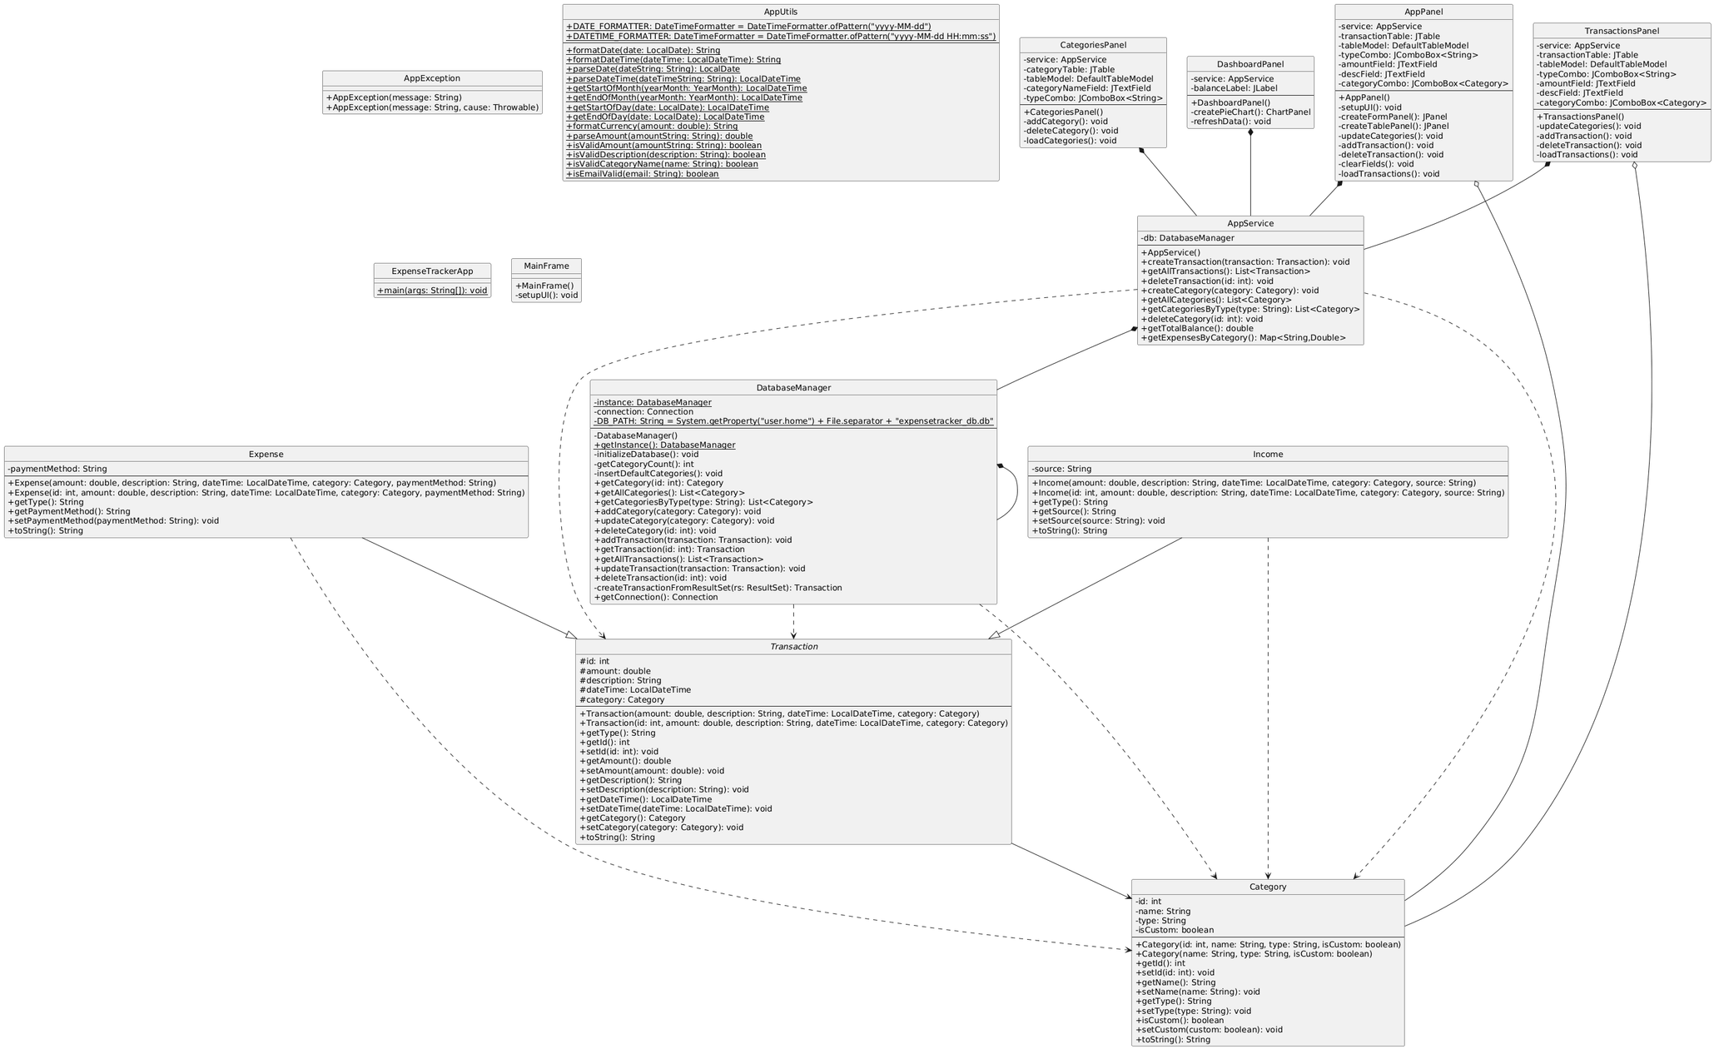

Slide 3
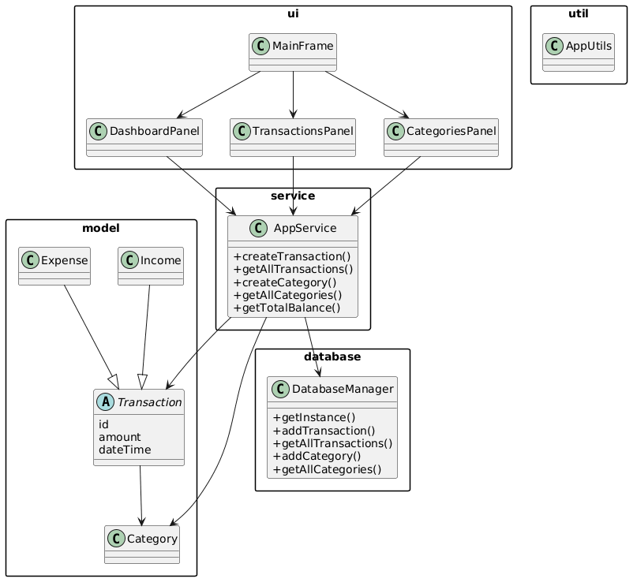
02
SYSTEM DESIGN
UI Layer (ui package)
MainFrame - ui (DashboardPanel, TransactionsPanel, CategoriesPanel), service (AppService)
DashboardPanel - service (AppService), model (Transaction, Category), util (AppUtils)
TransactionsPanel - service (AppService), model (Transaction, Expense, Income, Category), util (AppUtils)
CategoriesPanel - service (AppService), model (Category)
Service Layer (service package)
AppService - database (DatabaseManager), model (Transaction, Expense, Income, Category), util (AppUtils), exception (AppException)
Model Layer (model package)
Transaction (abstract) - model (Category), java.time (LocalDateTime)
Expense - model (Transaction, Category)
Income - model (Transaction, Category)
Database Layer (database package)
DatabaseManager - model (Transaction, Expense, Income, Category), java.sql (Connection, ResultSet, etc.), util (AppUtils)
Utility Layer (util package)
AppUtils - java.time (LocalDate, LocalDateTime, YearMonth), java.time.format (DateTimeFormatter)
Exception Layer (exception package)
AppException - java.lang (Exception / RuntimeException)

Slide 4
03
OOP CONCEPTS
Abstraction: Implementation of Data Access Objects (DAO) to define database interactions without exposing internal SQL logic.
Inheritance: Use of extends for UI components and inheriting from base service classes to maintain consistent behavior.
Polymorphism: Method overriding in different panel classes (DashboardPanel, TransactionsPanel, CategoriesPanel) to handle different data display logic dynamically.
Exception Handling: Implementation of try-catch-finally blocks for database I/O operations and handling NullPointerExceptions during view binding.
Collections: Use of List<Transaction>, ArrayList, and Map for data sorting and categorization. HashMaps store expense-by-category data for pie chart visualization.
Threading: Database operations are handled to prevent blocking the Main UI Thread.

Slide 5
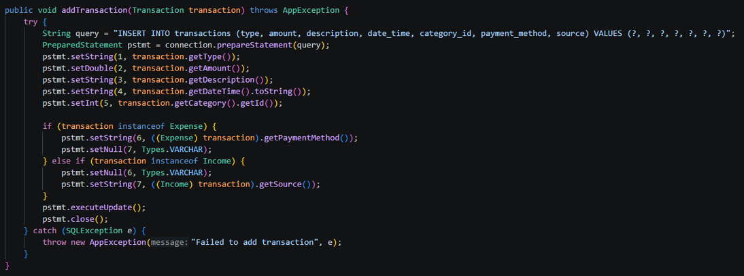
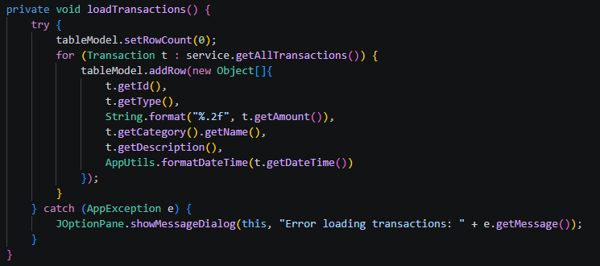
04
TECHNICAL HIGHLIGHT
Adding a Transaction via Service Layer
Fetching and Displaying Transactions
Exception Handling in the UI

Slide 6
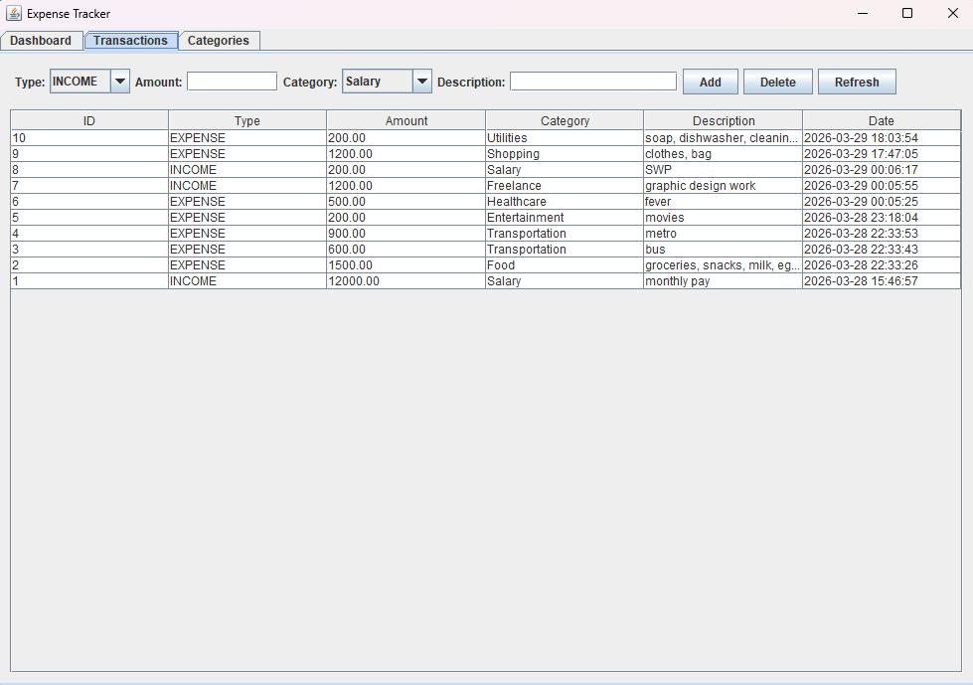
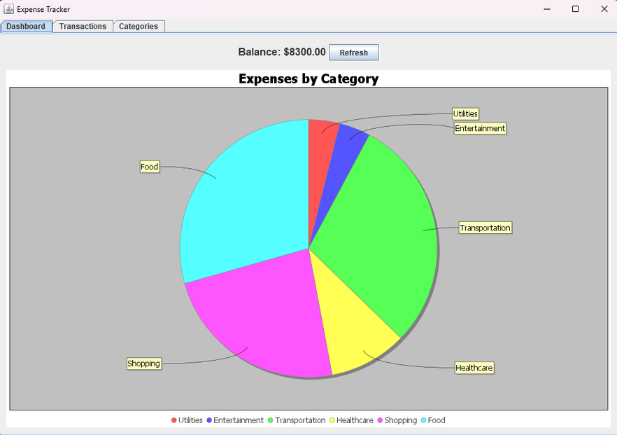
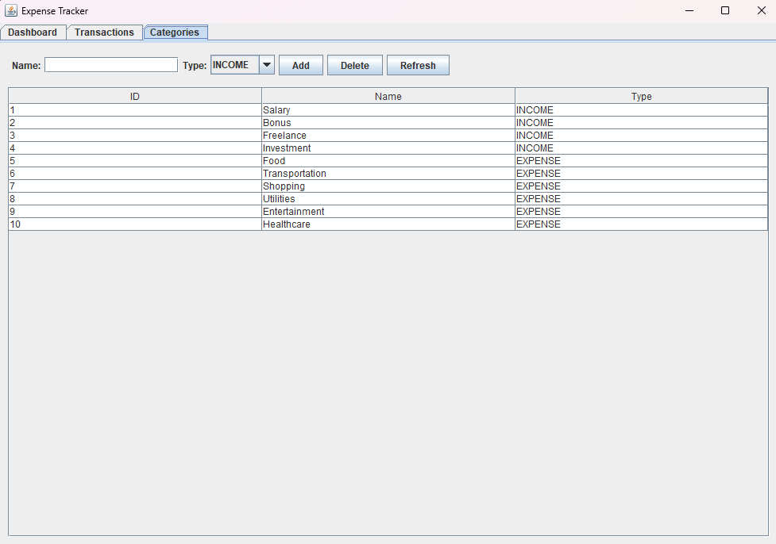
05
LIVE DEMO

Slide 7
06
THANK YOU
Sangram Keshari Patra

